Slide 1
9/11 Geographic Archive
Sample Assets

Slide 2
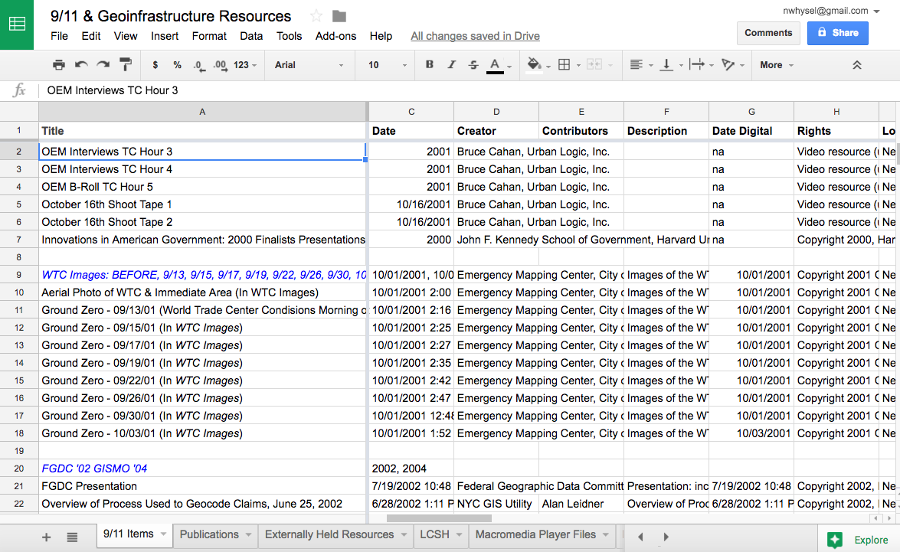
Notes:
The NYC Geospatial Technology Center has been created with funding from the Fund for the City of New York. Alan Leidner, former GIS Director and Assistant Commissioner of the NYC Department of Information Technology and Telecommunications is the director. The 9/11 Geospatial Archive is a key project along with the Coalition of Geospatial Information Technology Organizations, or COGITO, which I am coordinating with additional funding from FCNY. We have collected over 650 digital and physical items including videos, maps and electronic geospatial data.

Slide 3
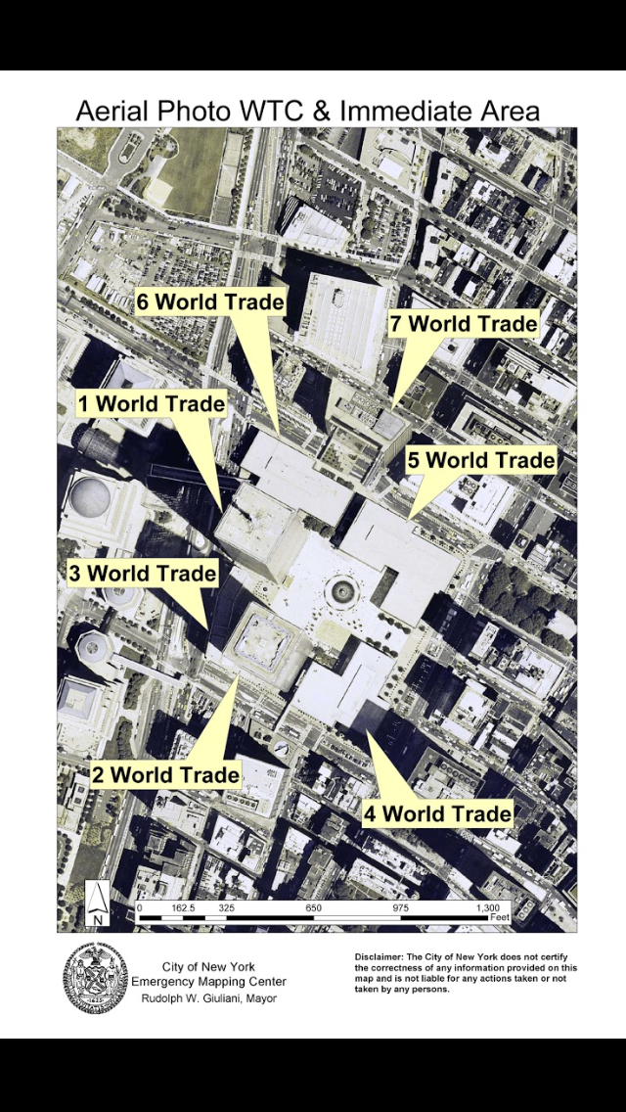
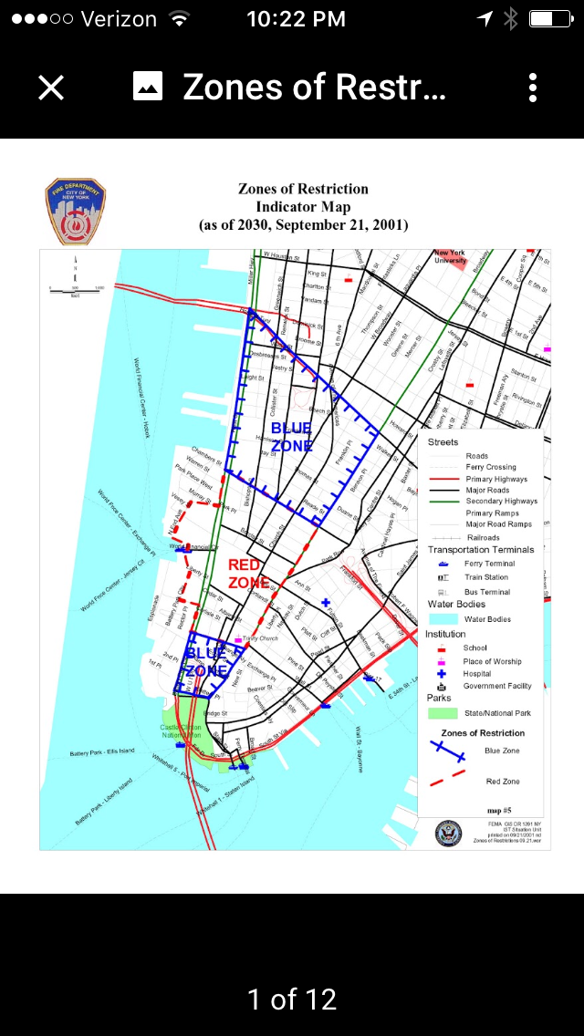
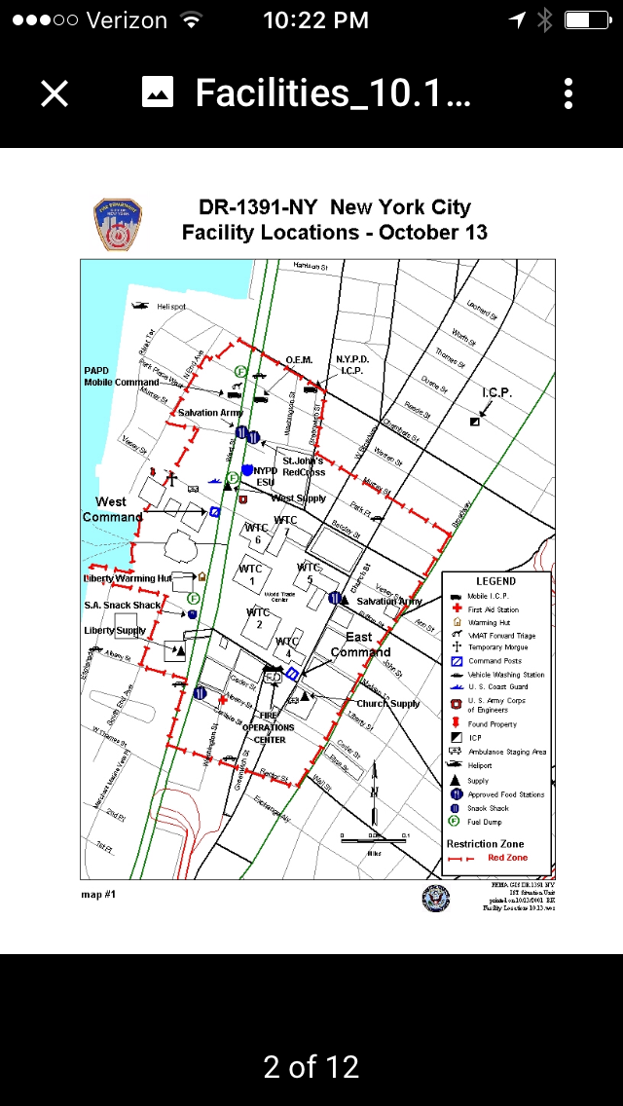
Notes:
Here are examples of some of the materials we have collected. Maps of Restriction zones and affected facilities, Aerial photos. These were prepared by the Fire Department and the Emergency Mapping Center at Pier 92.

Slide 4
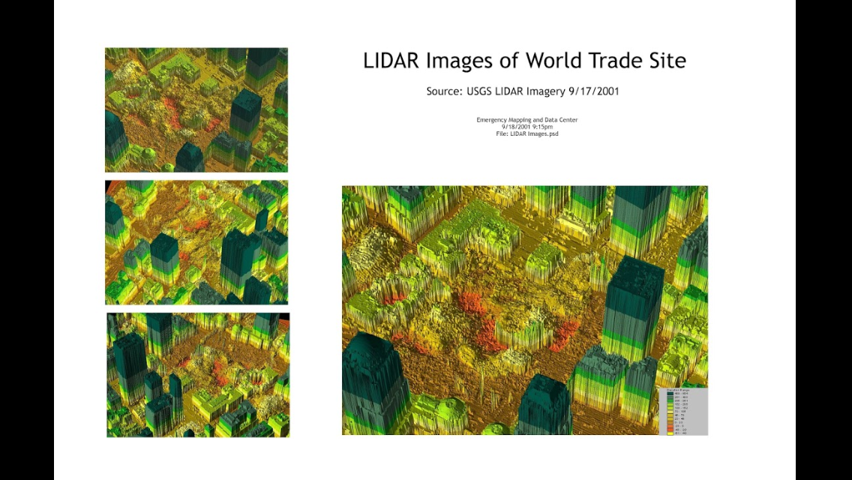
Notes:
LIDAR images showing the extent of damage. Also created by the Emergency Mapping and Data Center on September 17.

Slide 5
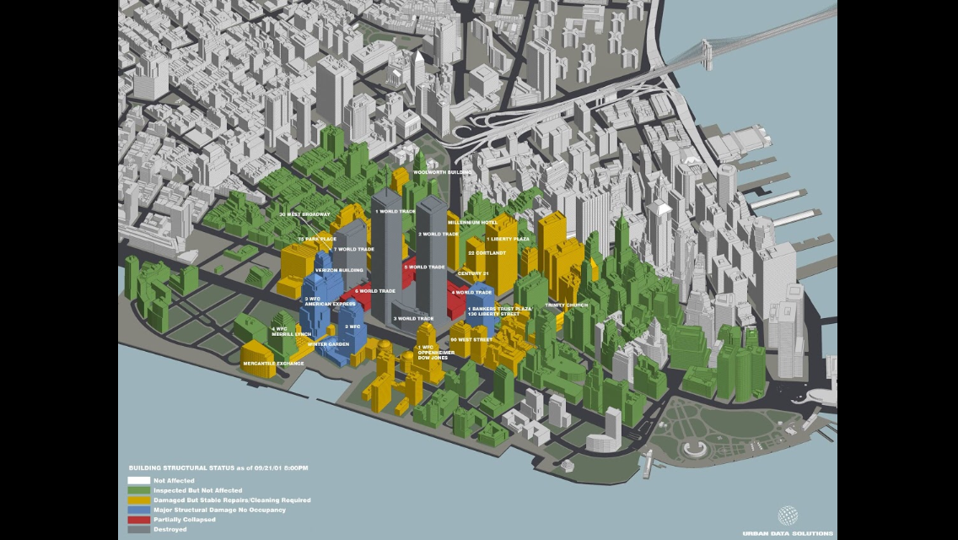
Notes:
Structural Status of buildings in the vicinity of the attack. These were created on September 21, 2001 by Urban Data Solutions, a commercial partner.

Slide 6
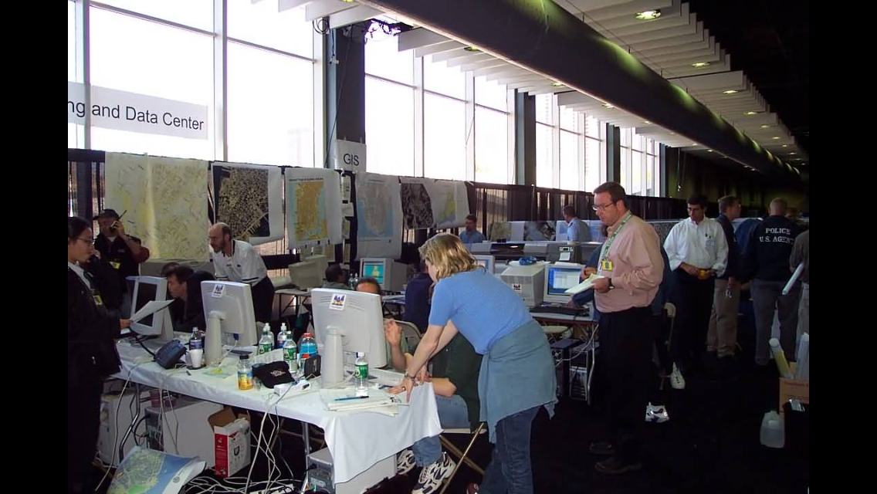
Notes:
We also have a large number of photographs of the Emergency Mapping and Data Center at Pier 92. Alan Leidner is in the white shirt over here on the left.

Slide 7
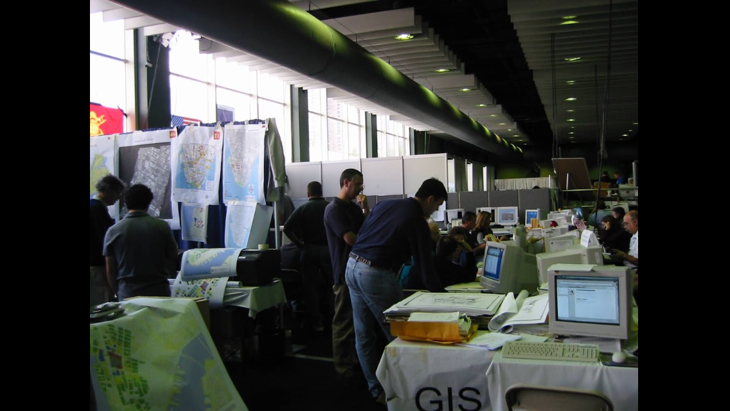
Notes:
Another shot of the EMDC

Slide 8
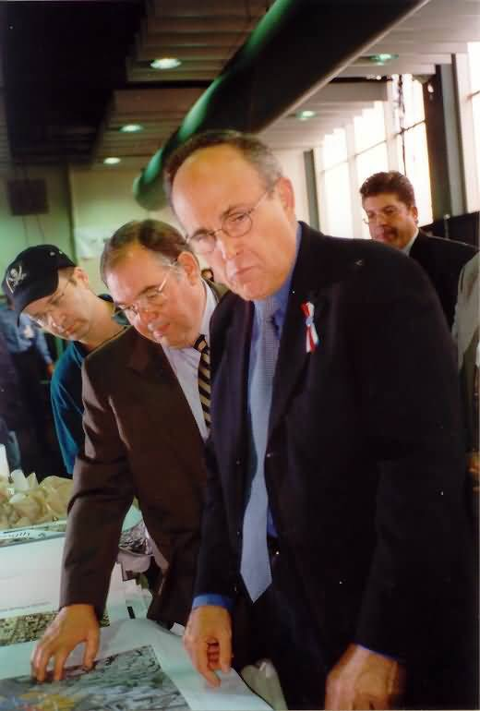
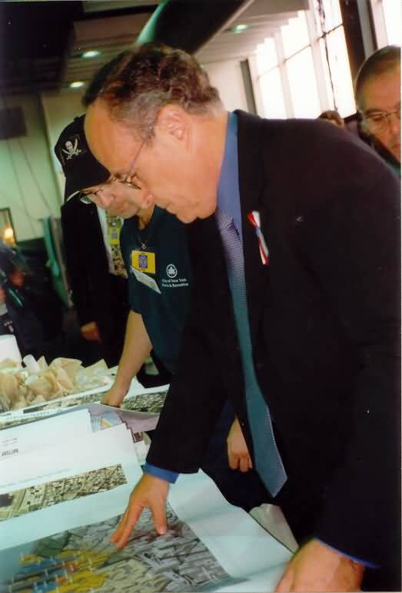

Slide 9
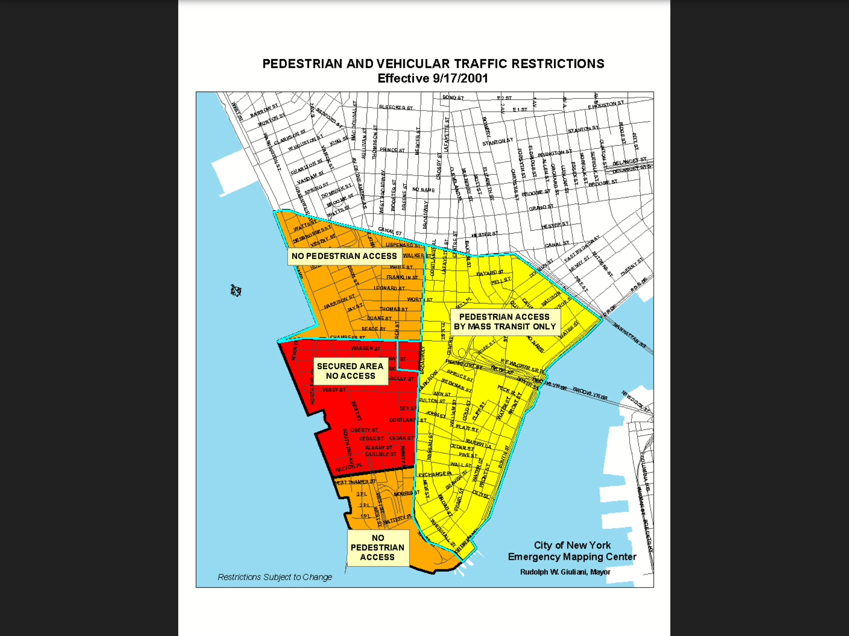
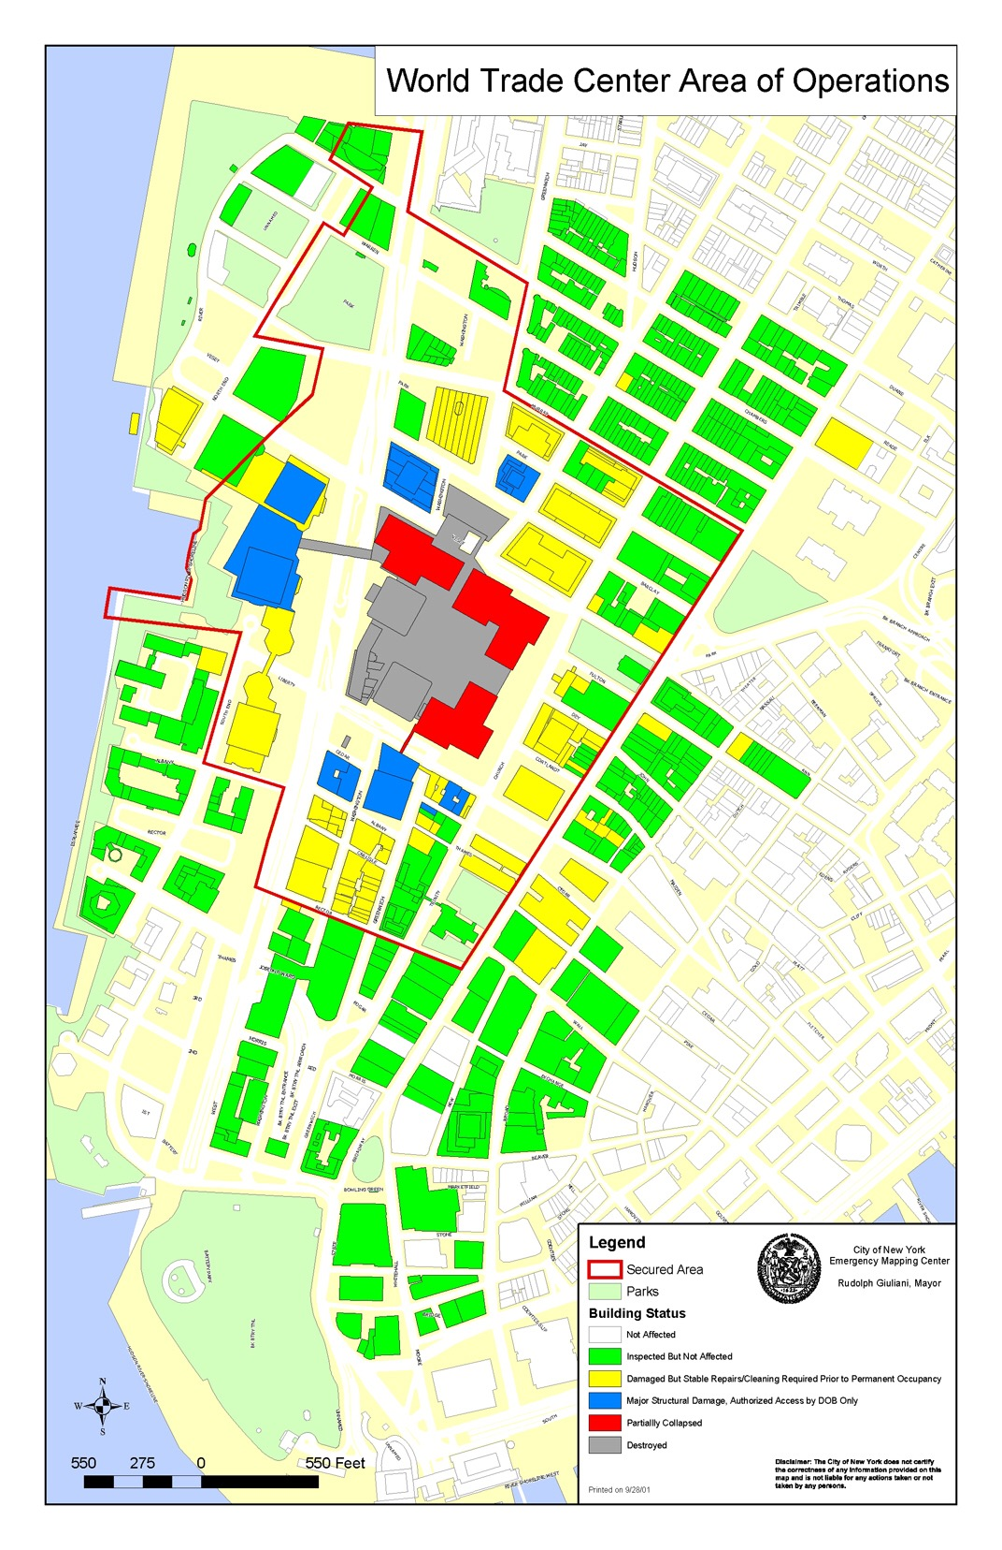

Slide 10
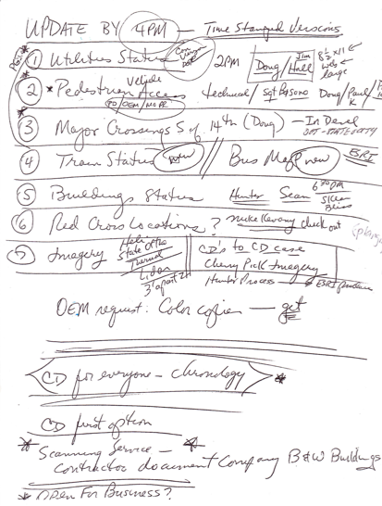
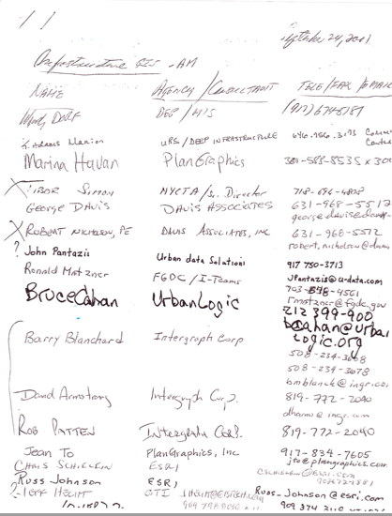
Meeting Notes
Notes:
We have been able to collect names of people who participated from signin sheets, meeting notes and other documentation. LinkedIn has been a great way to find out where people who participated then are now, so we can interview them to discover additional artifacts that may be hidden in personal collections. We also have video interviews from the week following 9/11 identifying participants.

Slide 11
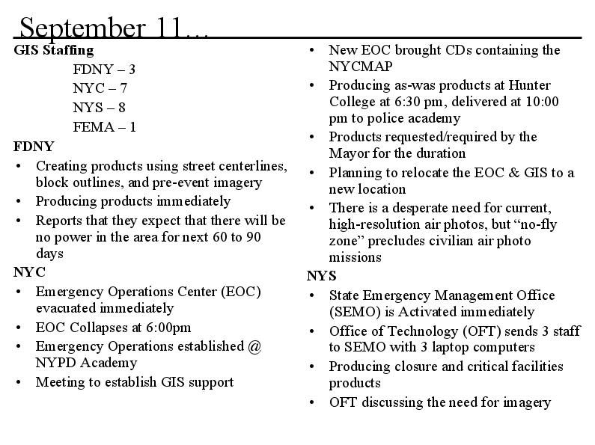
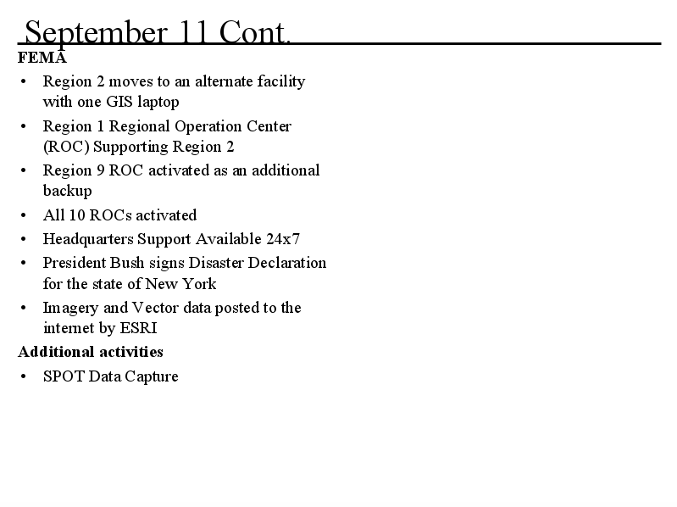
Chronology
Notes:
Chronology of activities from September 11 to October 12.

Slide 12
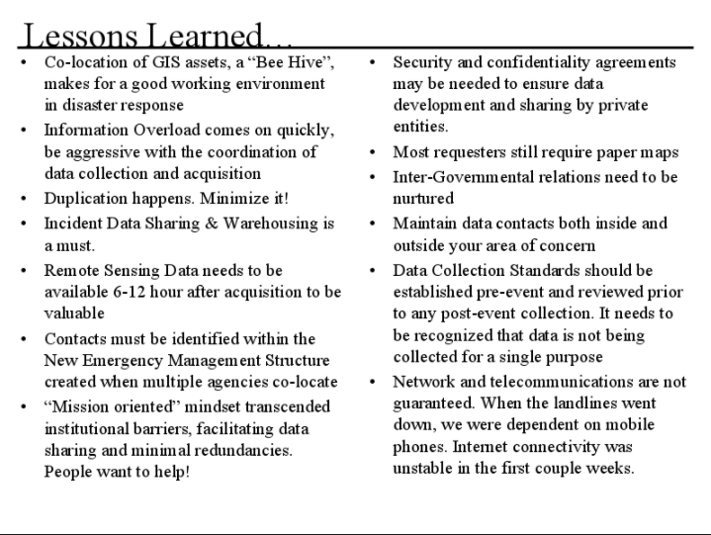
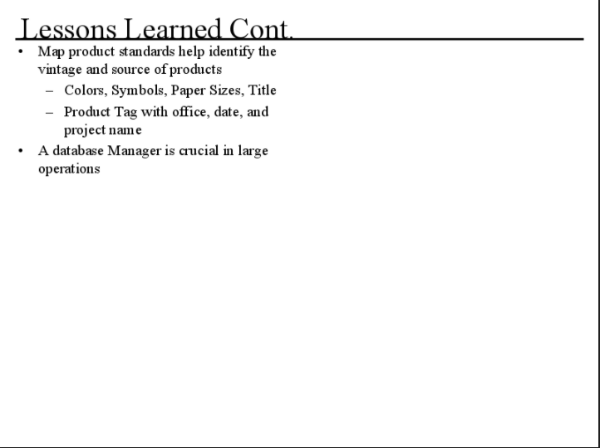
Lessons Learned
Notes:
This document contains information about participants and lessons learned in the weeks following the attack. This is resilience in action, since it forms policies and planning for future events.

Slide 13
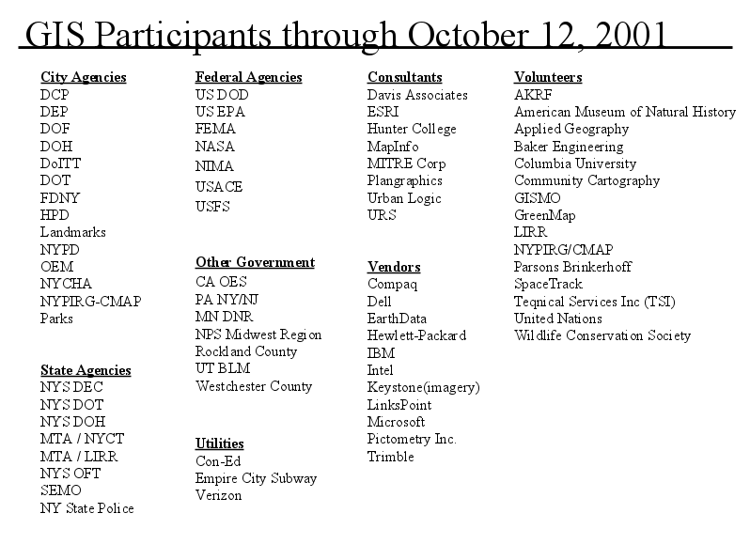
Collaborative Effort
Notes:
LIsts of participant agencies, vendors and volunteers

